Slide 1
Azure Machine Learning Adoption Framework Overview
Notes:
Welcome slide

Slide 2
Agenda
Overview of the Azure Machine Learning Adoption Framework
Define your strategy
Put together your AML adoption plan

Slide 3
Overview of the Azure Machine Learning Adoption Framework
Notes:
Ref: https://docs.microsoft.com/en-us/azure/cloud-adoption-framework/overview

Slide 4
Azure Machine Learning Adoption Framework
Best practices
Templates
People
Process
Technology
Achieve balance
Documentation
Tools
Control & Stability
Speed & Results
Align business, people and technology strategy.
Achieve business goals with actionable, efficient, and comprehensive guidance.
Deliver fast results with control and stability.
Notes:
<Key point>: Change is more than adopting technology. It’s adapting how you do business.
The Microsoft Cloud Adoption Framework for Azure means changing how you do business—not just swapping out technology, but changing your enterprise, the culture behind it, and you too.
We share best practices from our employees, partners, and customers who have already undertaken the cloud journey.
The Cloud Adoption Framework brings together people, process, and technology—a strategy that’s aligned to your business goals.
Quickly—efficiently, and with actionable guidance, it provides guidance for your organization’s agile business transformation.
Leading people through change is difficult. It’s not just the technology that changes. It’s your people and processes too.
We can help guide you through.
<Transition>: How does the Cloud Adoption Framework work for your business?

Slide 5


Azure Machine Learning Adoption Framework
Define strategy
Define business justification and expected outcomes
Understand motivations
Business outcomes
Business justification
Prioritize projects
Plan
Align actionable AML adoption plan to business outcomes
Digital estate
Initial organization alignment
Skills readiness plan
AML adoption plan
Ready
Prepare people, process and environment for change
AML readiness guide
First adoption project
Expand the blueprint
Best practices validation
Adopt
Migrate or Innovate
Implement desired changes across IT and business processes
Migrate
First project migration
Expanded scenarios
Best practices validation
Process improvements
Innovate
Innovation guide
Expanded scenarios
Best practices validation
Process improvements
Govern
Comply, control and secure
Methodology
Benchmark
Initial best practice
Governance maturity
Manage
Operate and optimize
Business commitments
Operations baseline
MLOps maturity

Slide 6
Azure Machine Learning Adoption Framework
Define strategy
Define business justification and expected outcomes
Understand motivations
Business outcomes
Business justification
Prioritize projects
Plan
Align actionable AML adoption plan to business outcomes
Digital estate
Initial organization alignment
Skills readiness plan
AML adoption plan
Ready
Prepare people, process and environment for change
AML readiness guide
First adoption project
Expand the blueprint
Best practices validation
Adopt
Migrate or Innovate
Implement desired changes across IT and business processes
Migrate
First project migration
Expanded scenarios
Best practices validation
Process improvements
Innovate
Innovation guide
Expanded scenarios
Best practices validation
Process improvements
Govern
Comply, control and secure
Methodology
Benchmark
Initial best practice
Governance maturity
Manage
Operate and optimize
Business commitments
Operations baseline
MLOps maturity

Slide 7
Define your strategy
Notes:
Ref: https://docs.microsoft.com/en-us/azure/cloud-adoption-framework/overview

Slide 8
Define Strategy
Document your AML strategy to help stakeholders understand the business outcomes the organization is pursuing by adopting AML.
1
Motivations
Understand motivations to move to AML.
2
Business Outcomes
Engage stakeholders to document specific business outcomes.
3
Business Justification
Develop a business justification that supports your motivations and outcomes.
4
Identify First Project
Leverage business and technical criteria to choose your first project.

Slide 9
AML Adoption Strategy | AML Adoption Motivations Engage stakeholders across business and technology to understand your motivations for AML adoption
Migration Motivations
Optimization of internal operations
Increase in business agility and/or complexity
Preparation of new technical capabilities
Scalability to meet market demands
Critical Business Events
Reduction of response time to business requirements
Response to regulatory compliance changes
Reduction of disruptions and improvement of MLOps stability
Disrupt existing markets
Expand into new markets
Create new markets
Innovation Motivations
Preparation for new technical capabilities
Build new technical capabilities
Scalability to meet market demands
Improved customer experience
Transformation of products or services
Market disruption with new products or services
ML democratization and/or self-service environments
Increase transparency and responsibility
Notes:
<Key point>: There is no single, typical cloud adoption motivation in cloud adoption—typically there are more than one.
Cloud adoption is an iterative process. There can be many motivations for why your organization is planning digital transformation.
It’s important to engage cross-functional business groups across the enterprise to explore cloud adoption motivations.
[Go through list of Critical Business Events.
[Read through Migration Motivations and Innovation Motivations]

Slide 10

Define Strategy | Identify Business Outcomes Engage different stakeholders and document desired outcomes across these categories
Fiscal outcomes include better understanding and planning of costs, optimized cost allocation, and reuse of existing investments
Agility outcomes include decreased time-to-market, elastic resource allocation and consumption, and personalized AML environments
Customer engagement outcomes include alignment of products and/or services with customer needs, creation of new markets, and disruption of existing markets
Performance outcomes include availability of high-performance Machine Learning compute resources, and reutilization of existing data science / data engineering compute resource investments
Responsibility & Transparency outcomes include responsible AI and Machine Learning
Security & Compliance outcomes include regulations addressed and implemented

Slide 11
Define Strategy | Identify Business Outcomes Engage different stakeholders and document desired outcomes across these categories
Business Drivers | KPI | Capabilities
High Priority
Stake holder:
Outcome:
Business driver 1 | Success metric 1 | Required capability 1
Business driver 2 | Success metric 2 | Required capability 2
Business driver 3 | Success metric 3 | Required capability 3
Business Drivers | KPI | Capabilities
Mid Priority
Stake holder:
Outcome:
Business driver 1 | Success metric 1 | Required capability 1
Business driver 2 | Success metric 2 | Required capability 2
Business driver 3 | Success metric 3 | Required capability 3
Business Drivers | KPI | Capabilities
Low Priority
Stake holder:
Outcome:
Business driver 1 | Success metric 1 | Required capability 1
Business driver 2 | Success metric 2 | Required capability 2
Business driver 3 | Success metric 3 | Required capability 3
Business Drivers | KPI | Capabilities
High Priority
Stake holder:
Outcome:
Business driver 1 | Success metric 1 | Required capability 1
Business driver 2 | Success metric 2 | Required capability 2
Business driver 3 | Success metric 3 | Required capability 3
Business Drivers | KPI | Capabilities
Mid Priority
Stake holder:
Outcome:
Business driver 1 | Success metric 1 | Required capability 1
Business driver 2 | Success metric 2 | Required capability 2
Business driver 3 | Success metric 3 | Required capability 3
Business Drivers | KPI | Capabilities
Low Priority
Stake holder:
Outcome:
Business driver 1 | Success metric 1 | Required capability 1
Business driver 2 | Success metric 2 | Required capability 2
Business driver 3 | Success metric 3 | Required capability 3

Slide 12


Define Strategy | Develop Business Justification
Beyond achieving business outcomes, identify other indicators for successful adoption of AML and capture the information in a business case
Problem definition and scope
Alignment with business strategy and goals
Possible outcomes and benefits
Project outline and timeline
Risks
Costs

Slide 13



Define Strategy | Identify First Project
Choose the first project to move to AML by using a clearly defined criteria and clearly identified outcomes to achieve.
First Project Criteria
First Project Expectations
First Project Examples for each motivation category
Should align with your motivations for AML adoption
Should demonstrate progress towards a defined business outcome
Project is a source of learning.
It might result in production deployments, but it will probably require additional effort first.
The output of this project is a set of clear requirements to provide a longer-term production solution.
Critical business events: Use AML in combination with Azure Pipelines or GitHub Actions to implement an end-to-end MLOps process.
Migration motivations: Migrate a project to AML to benefit from the removal of the 10 GB training data limit
Innovation motivations: Use the AML Studio experience and Compute Instances to provide personalized ML environments for data scientists.

Slide 14
Define Strategy | Identify First Project
Choose the first project to move to AML by using a clearly defined criteria and clearly identified outcomes to achieve.
Project: | Stakeholder: | Outcome: | Business Unit:
AML Adoption Strategy Team
Name | Business Unit / Role | Business Outcome Owner (Y/N) | AML Adoption Strategy Team (Y/N)

Slide 15
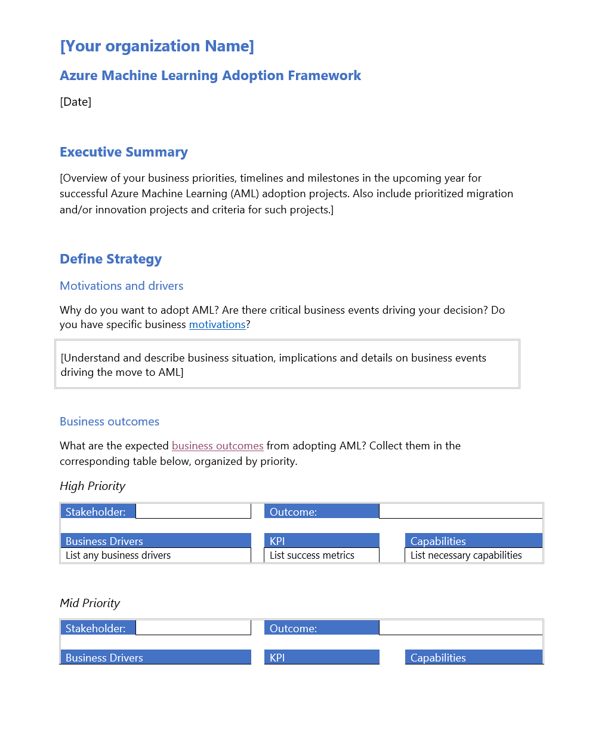
Define Strategy | AML Adoption Strategy and Plan Template
An AML adoption plan converts the aspirational goals of the AML adoption strategy into an actionable plan
All the data science teams leverage the AML adoption plan to guide technical efforts, in alignment with the business outcomes.
Download the template and get started with creating your plan

Slide 16
Putting together your plan
Notes:
Ref: https://docs.microsoft.com/en-us/azure/cloud-adoption-framework/overview

Slide 17
Plan
AML adoption plans convert the aspirational goals of the AML adoption strategy into actions. It will help guide technical efforts, in alignment with the business strategy.
1
Rationalize Digital estate
Rationalize your digital estate to determine best approach to AML adoption.
2
Initial org alignment
Align governance and AML adoption to mitigate risks.
3
Skills readiness plan
Get your people ready by identifying skills gap and plan.
4
Cloud adoption plan
Create an actionable AML adoption plan that aligns to your business strategy.

Slide 18
Plan | Rationalize Digital Estate
Rationalization is the process of evaluating assets to determine the best approach to migrate them in AML workspaces
In enterprise scenarios, rationalization can take place using an incremental approach or ‘Power of 10’ where the AML strategy team selects the first 10 models to be migrated which are a mix of simple and complex workloads; (recommended approach)
The output of a rationalization effort is a prioritized backlog of all assets that are affected by the chosen transformation.
Use effort and cost evaluation to take the final decisions

Slide 19
Plan | Rationalize Digital Estate
Migration targets: create a centralized list of all ML Classic projects suited for initial migration
ML Project / Workload | Business Unit | Business Priority (high, mid, low) | Proposed Rationalization
Innovation targets: opportunities to improve your customer experience, opportunities to innovate
ML Project / Workload | Business Unit | Business Priority (high, mid, low) | Proposed Rationalization

Slide 20

Plan | Initial Org Alignment
Implementing AML adoption plan requires some initial alignment of different stakeholders who will make the plan a reality.
AML Adoption Team
AML Governance Team
Speed vs. Control
Create a balance between speed or moving quickly and control or reducing risks by have teams accountable for adoption and governance.
While AML adoption team is required to execute AML adoption tasks, governance team ensures processes and controls are implemented.

Slide 21
Plan | Initial Org Alignment
Name of people responsible for…
Delivering technical tasks | Implementing AML governance

Slide 22
Plan | Skills Readiness Plan
For successful AML adoption, it’s critical to ensure your people, IT and non-IT, are ready for this transformation. Including in the table below, the key courses your organization needs to take for this process.
Course name | Audience (Data Architect, Data Scientist, Data Engineer, IT, Admin, Ops) | Level (100, 200, 300, 400) | Source (MS Learn, other) | Priority (high, mid, low)
Notes:
https://docs.microsoft.com/en-us/azure/cloud-adoption-framework/plan/suggested-skills

Slide 23
Plan | AML Adoption Plan
Translate strategy and effort into an actionable AML adoption plan.
Prerequisites: Confirm that all prerequisite steps have been completed before you create your plan.
Define and prioritize workloads: Prioritize your first workload(s) to establish an initial adoption backlog.
Align assets: Identify which assets (proposed or existing) are required to support the prioritized workloads.
Review rationalization: Review rationalization decisions to refine adoption-path decisions: Migrate or Innovate.
Define iterations and releases: Iterations are the time blocks allocated to do work. Releases are the definition of the work to be done before triggering a change to production processes.
Estimate timelines: Establish rough timelines for release planning purposes, based on initial estimates.

Slide 24
Azure Machine Learning Adoption Framework
Define strategy
Define business justification and expected outcomes
Understand motivations
Business outcomes
Business justification
Prioritize projects
Plan
Align actionable AML adoption plan to business outcomes
Digital estate
Initial organization alignment
Skills readiness plan
AML adoption plan
Ready
Prepare people, process and environment for change
AML readiness guide
First adoption project
Expand the blueprint
Best practices validation
Adopt
Migrate or Innovate
Implement desired changes across IT and business processes
Migrate
First project migration
Expanded scenarios
Best practices validation
Process improvements
Innovate
Innovation guide
Expanded scenarios
Best practices validation
Process improvements
Govern
Comply, control and secure
Methodology
Benchmark
Initial best practice
Governance maturity
Manage
Operate and optimize
Business commitments
Operations baseline
MLOps maturity

Slide 25
Thank you
Notes:
Thank You

